Slide 1
Earth Science
Plate Tectonics workbook wkst p 218-219 and 220

Slide 2
Layers of the earth / 2. chart
Crust, 5/10-70 km thick, solid, granite / basalt
(LEAST DENSE)
b.Upper mantle, 660 km thick, partly molten rock, iron / magnesium (DENSER)
c. Lower mantle, 2225 km thick, solid dense material, magnesium / iron (MORE DENSE)
d. Outer core, 2270 km thick, liquid, iron / nickel
e. Inner core, 1216 km thick, solid, iron / nickel
(MOST DENSE)
Careful, they wanted it listed inner to outer but I chose to parallel the above diagram.

Slide 3
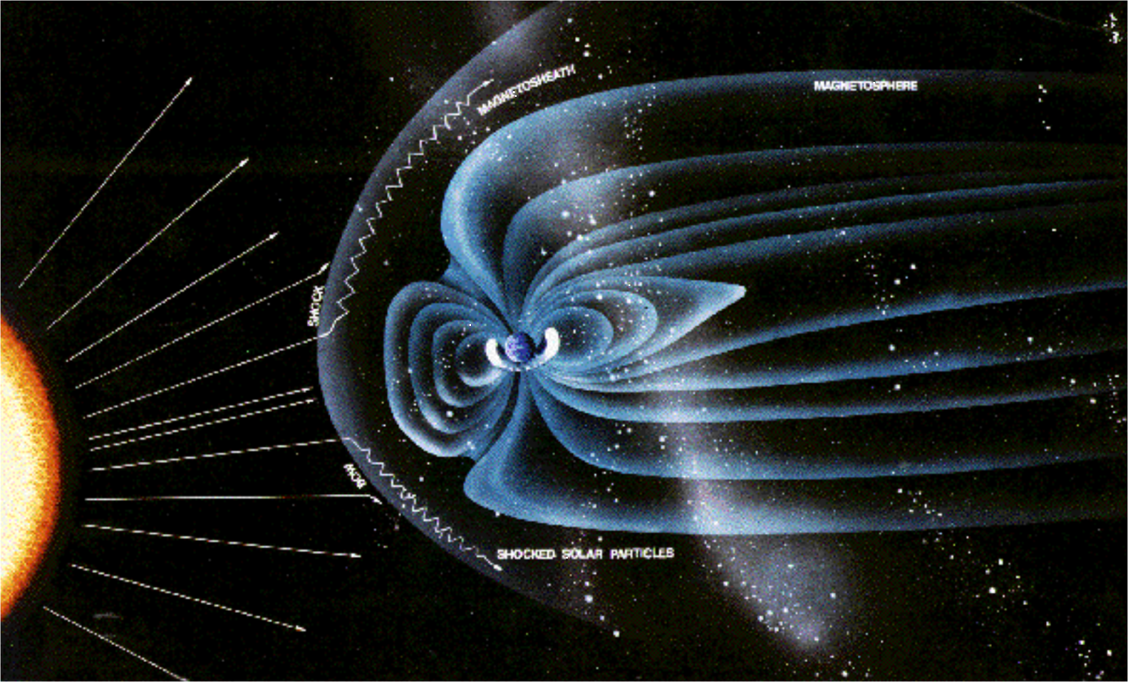

Slide 4
3. Difference between lithosphere and asthenosphere?
Lithosphere is crust and uppermost mantle.
Asthenosphere is partially molten layer of upper mantle just below the lithosphere.

Slide 5
WORKBOOK P 219

Slide 6
1. What do geologists believe heats the upper mantle portion of the asthenosphere?
Radioactive decay of radioactive elements like uranium.
Some books state that there is also left over heat from the Earth’s formation that is continually heating the Earth’s interior.

Slide 7
2. Driving forces behind plate movement?
Mantle convection or convection currents within the mantle.

Slide 8
3. Difference between rift valley and spreading ridge?
Rift valley occurs on land.
Spreading ridge occurs in the ocean.

Slide 9
4. What occurs when dense ocean plates collide with continental plate?
Subduction
The more dense ocean plate will dive under the less dense continental plate.

Slide 10
5. What events commonly occur at subduction zones?
Earthquakes and volcanic eruptions
Features would be mountains, volcanoes, trenches etc.

Slide 11
6. Draw / label symbols for plate interactions.

Slide 12
East African Rift
continental plate diverging
Juan de Fuca plate
small oceanic plate converging /
subducting under NA continental plate
Islands of Japan
Pacific plate (oceanic plate) subducting
under Eurasian plate (continental )
(small part of Philippine plate subducts
under Eurasian plate)

Slide 13
Himalayan mountains
2 continents converging, no subduction. Eurasian plate colliding
with the Indo-Australian plate
San Andreas Fault
Pacific plate (oceanic) sliding past a
continental plate (NA plate)

Slide 14
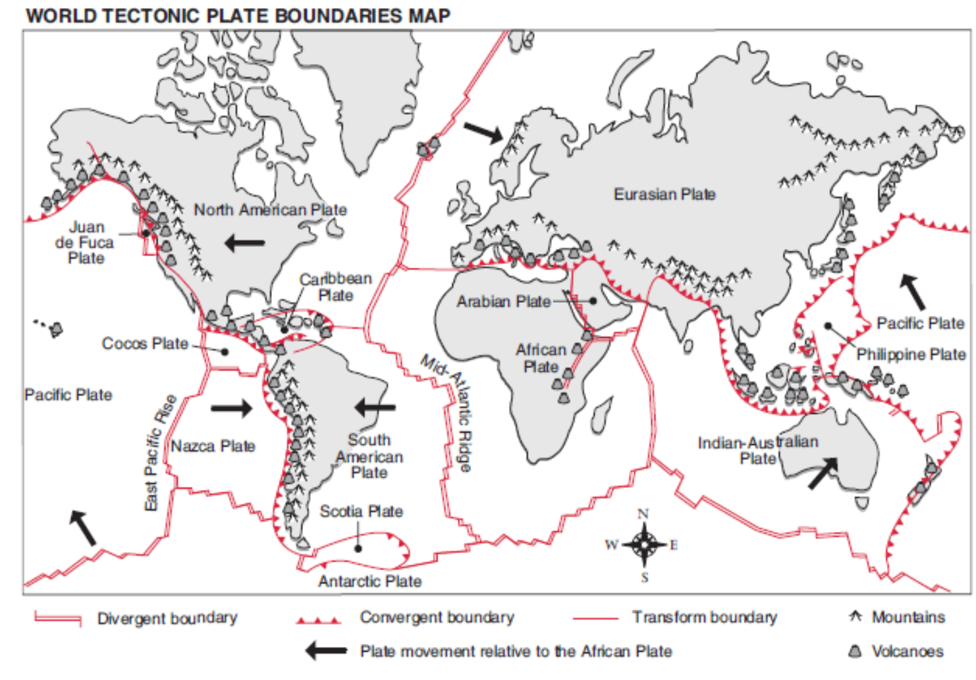

Slide 15
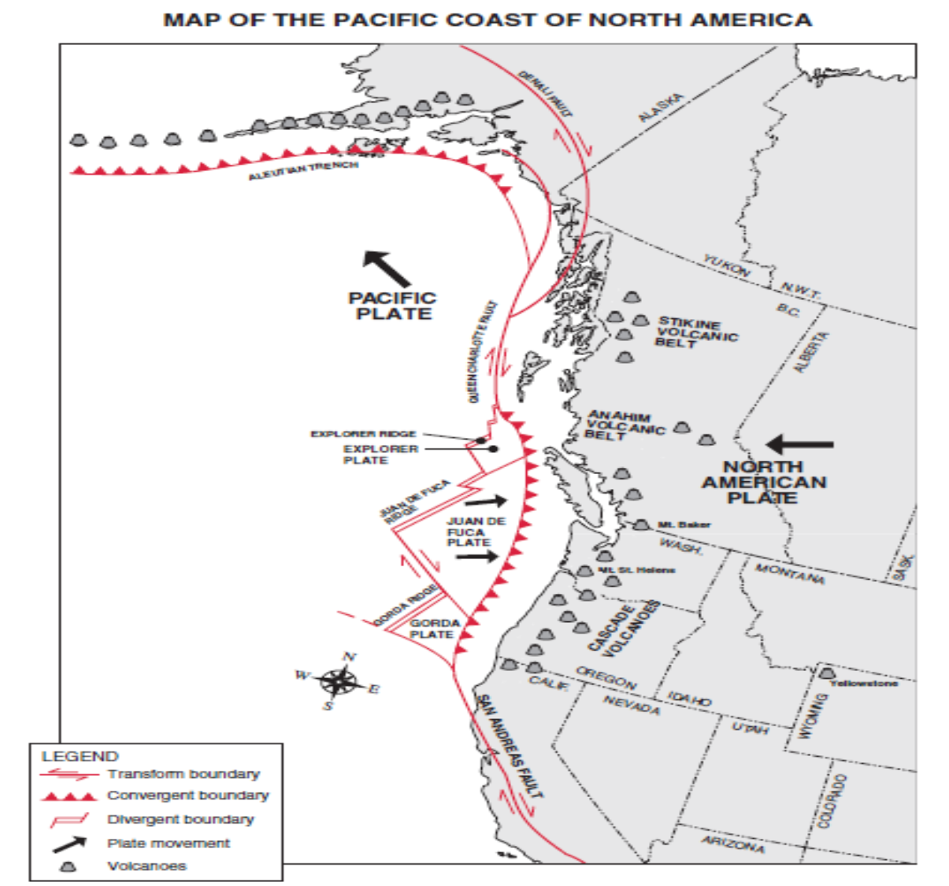

Slide 16
6. When continents collide, does subduction occur?
No, when continents collide, neither plate goes under so they crumple and fold upward creating high mountain ranges like the Himalayas.

Slide 17
Earth Science
Plate Tectonics workbook wkst p 220

Slide 19
2. Seismometer?
A device that measures the amount of ground motion caused by an earthquake.
AKA seismograph

Slide 20
3. How does the term magnitude relate to how earthquake activity is recorded?
Magnitude is a number that rates the strength or energy of an earthquake.
Higher magnitude numbers indicate larger more destructive earthquakes.

Slide 21
4. What scale is often used to measure magnitudes of earthquakes?
Richter scale.

Slide 22
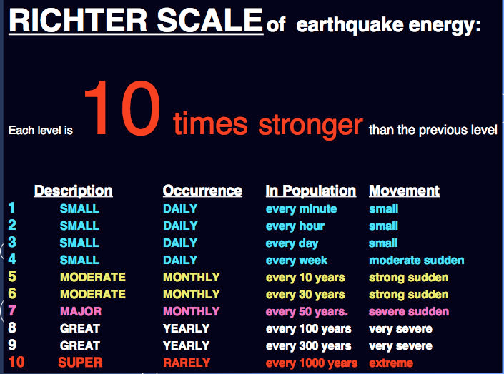

Slide 23
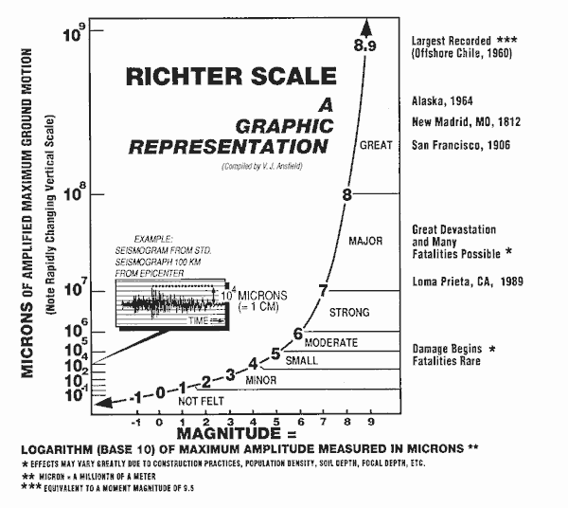

Slide 24
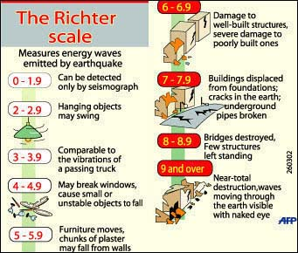

Slide 25
5. Difference between focus and epicentre?
Focus is where the earthquake started.
Epicentre is the point on the earth’s surface directly above the focus.
They can be the same point if the earthquake originated on the surface.

Slide 26
6. Classification scale used to describe depth of origin of earthquakes.
Table on page 528
Shallow focus 0-70 km below surface.
transform boundary
Intermediate focus 70-300 km below surface
Deep focus greater than 300 km below surface. = subduction boundaries

Slide 27
7. Fill in table.
Mt. Garibaldi volcano, composite volcano, eruptions from subduction zone, part of BC coastal mountains
Anahim Volcanic Belt, shield type volcano, central BC located over a hot spot.
Krafla volcano, Iceland, rift eruption volcano, rift eruption along cracks in lithosphere at spreading centres. Usually cone shaped and many in a line along the rift zone.

Slide 30
Page 522
Inner core, outer core, mantle, crust
Crust and uppermost mantle
Mantle convection / sea floor spreading, ridge push , slab pull
One plate going under another.

Slide 31
Page 526
converging, diverging, transform
Subduction from oceanic plates made of dense basalt rock gets pulled under the continental plate made of less dense granite.
2 oceanic plates colliding producing a subduction boundary, mountains are formed but the mountains are in the ocean so they are just islands.
Himalayas

Slide 32
Q. 1. 3 kinds of plate boundaries
Convergent
Divergent
transform

Slide 33
2. Ridge push
Convection currents moving magma upwards at spreading centres. As the magma reaches the surface, it pushes the plates away from each other.
Spread apart.

Slide 34
3. Volcanoes and earthquakes relate to tectonic plates?
Most of the world’s volcanoes and earthquakes occur along the plate boundaries.

Slide 35
4.a. convection currents?
Within the earth, hot magma rises to the crust, cooler magma moves down toward the core. This circular pattern of movement is called convection current.

Slide 36
4b. Convection current location?
Mantle
More specifically the asthenosphere.

Slide 37
4c. Convection current affect plates?
The movement of magma in the mantle moves the plates.

