Slide 1
Ch 12 wkst 1 continental drift

Slide 2
1. What is happening deep below BC and how much are we moving every year and in what direction?
Forces are churning melted rock (magma) and moving the land westward about 2 cm / year.

Slide 3
2. Read the beige section at the top of page 506.
Continents used to be joined together
Sea floor spreading
Continents are on huge slabs of rock called tectonic plates.

Slide 4
3. Define continental drift theory.
Continents have not always been in their present locations but have drifted there over millions of years.

Slide 5
4. Who first proposed the continental drift theory?
Alfred Wegener
***Know this name!!!

Slide 6
5. What is Pangaea?
All the continents joined together into a supercontinent called a pangaea

Slide 7
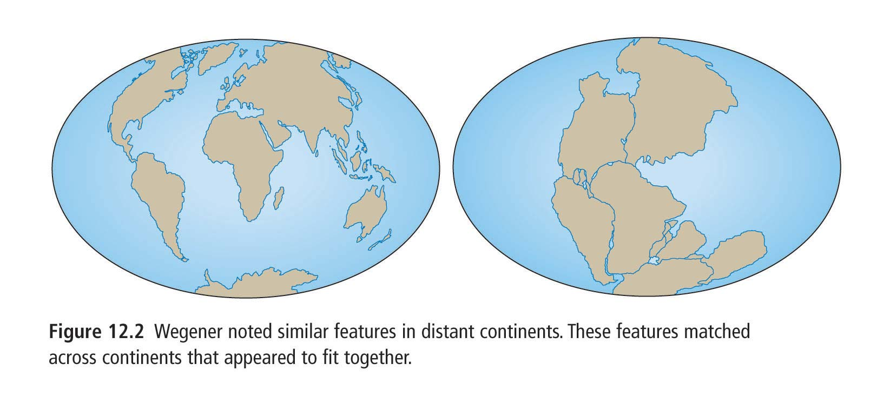
Page 507
Also p508 and 517 will help
For Pangaea activity

Slide 8
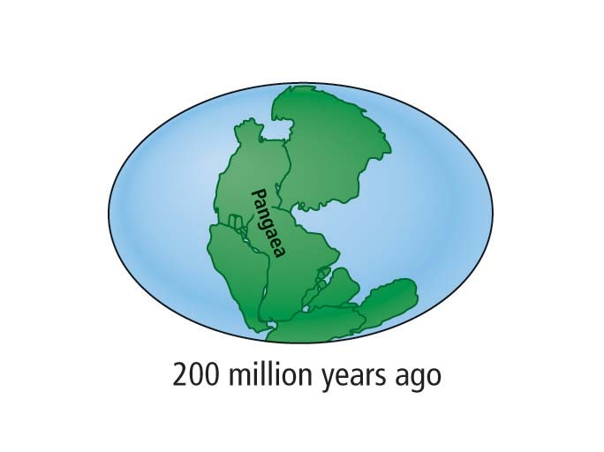
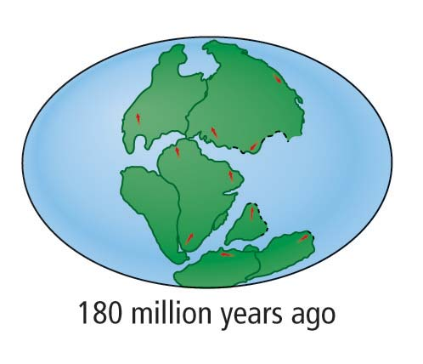
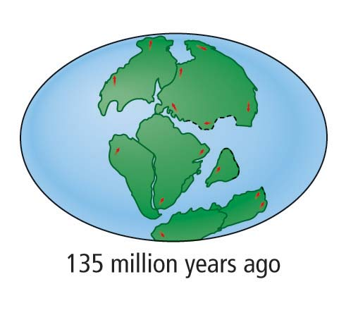
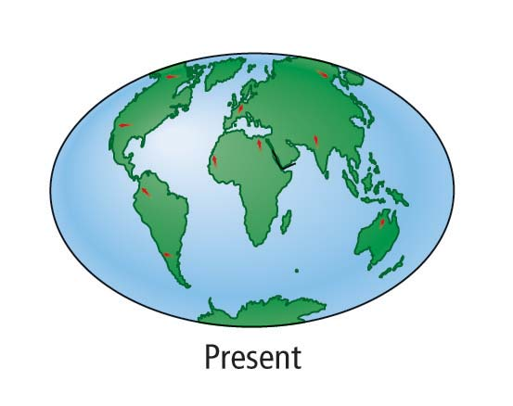
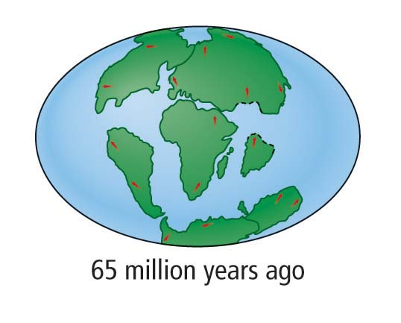

Slide 9
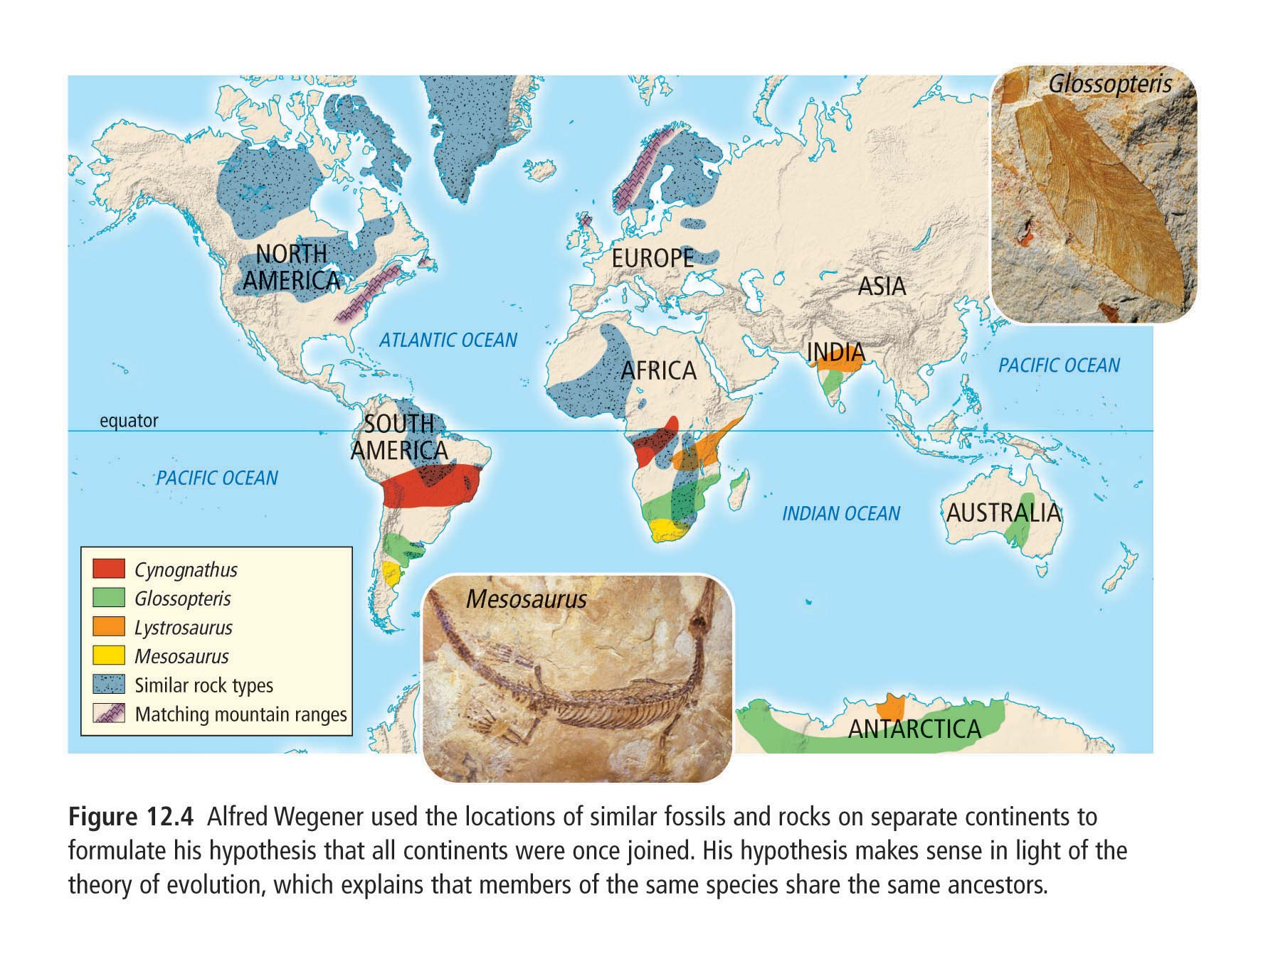

Slide 10
6. On pages 507 to 509, the 4 brown titles in the reading are the main pieces of evidence for continental drift. State them and give an example of each.

Slide 11
1. Jigsaw puzzle fit
Coastlines match up

Slide 13
2. Matching geologic structures and rocks
Mountain ranges that begin on one continent and end at a coastline then appear to continue on a continent across the ocean.
Folds in rock structures similar
Ages of rocks and types of rocks same on Newfoundland, Greenland, Ireland, Scotland, and Norway

Slide 14
3. Matching fossils
Fossils matching on continents that have an ocean separating them.
Mesosaurus was a freshwater reptile found only in two places on Earth, southeastern South America and southwestern Africa. It was not likely it crossed an entire ocean.
Other animals and plants have also been found spread apart on present day continents that is better explained if they were together
Antarctica having tropical plants suggest that it was once near the equator and moved to south pole.

Slide 16
4. Climatic evidence for continental drift.
Glacier evidence like U shaped valleys and rock markings in areas that are now tropical. If the supercontinent was joined and closer to the south pole, this makes sense that India, Africa, South America could have had glaciers.
Coal deposits in Antarctica. Again supporting that it was once near a warmer climate area.

Slide 17
7. Define paleoglaciation
Extent of ancient glaciers and rock markings left behind.

Slide 18
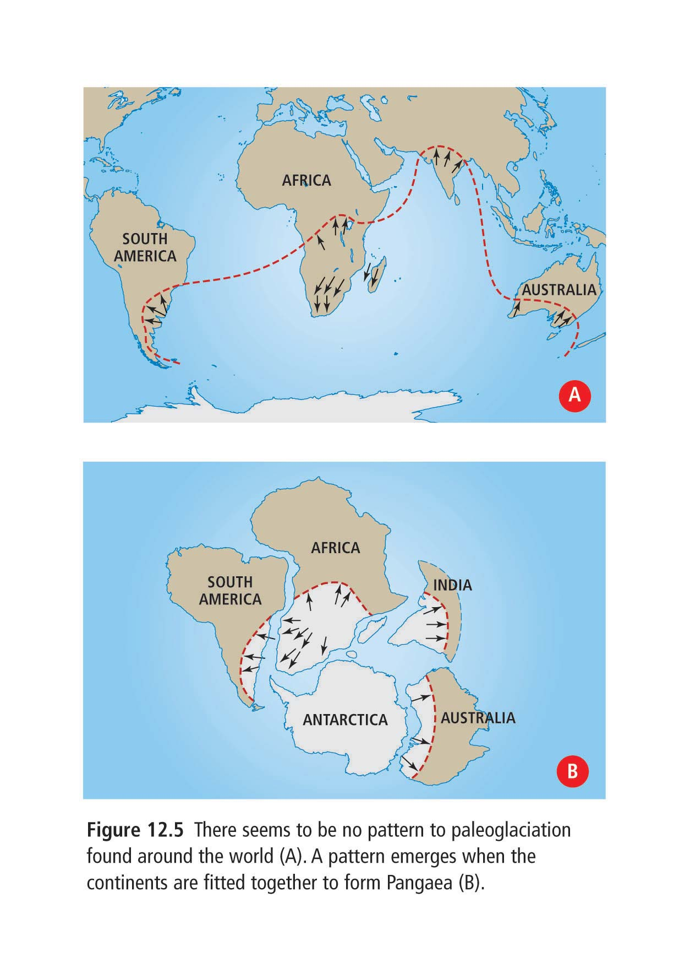

Slide 19
8. Define tectonic plates.
Large, movable slabs of rock that form the Earth’s surface.
They move over a layer of partially molten rock.

Slide 20
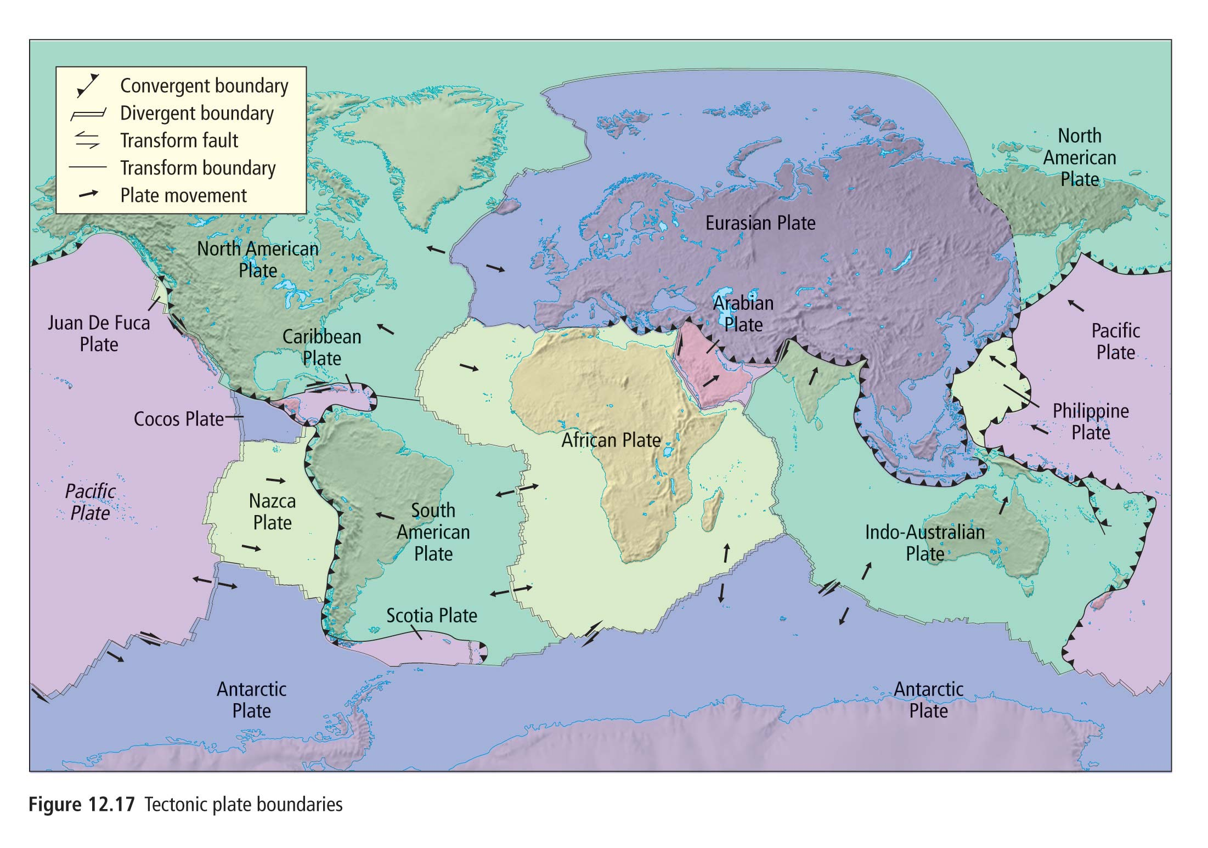

Slide 22
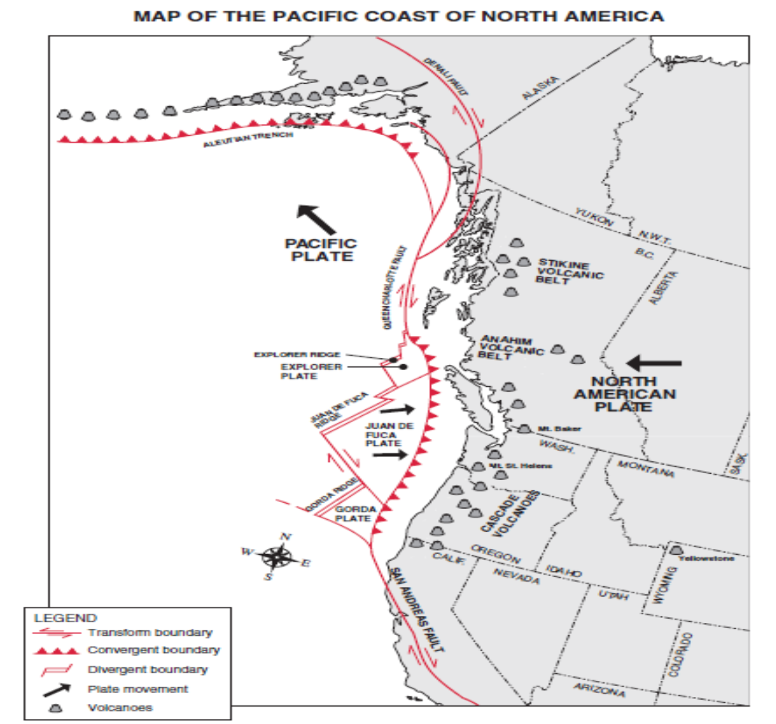

Slide 23
9. Define volcanoes.
Openings in the Earth’s surface that when active, spew out gases, chunks of rock and melted rock.

Slide 24
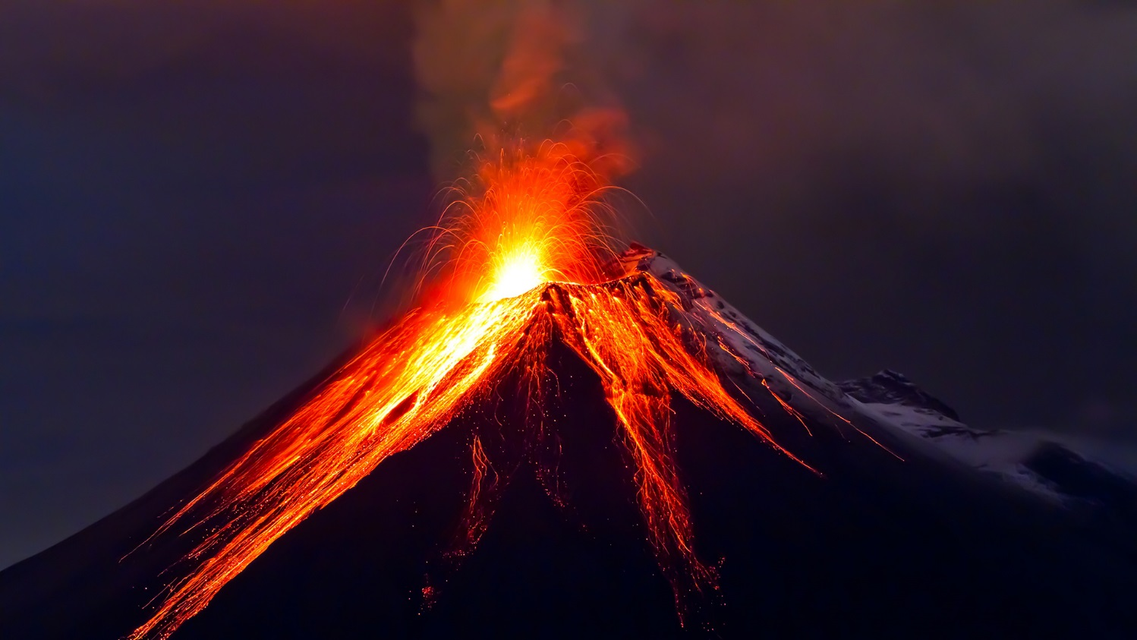
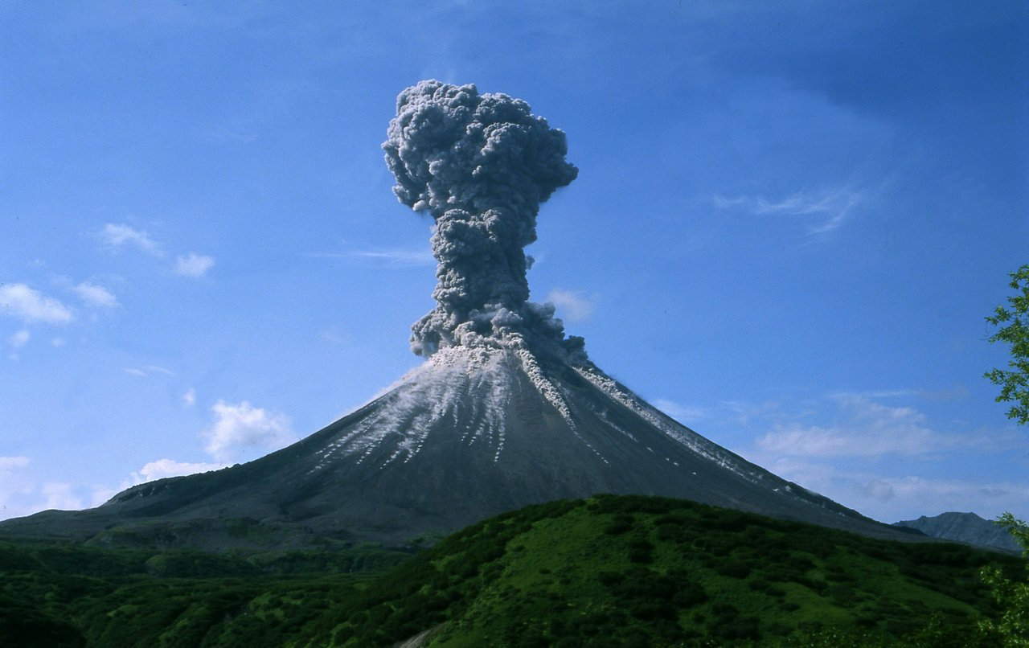

Slide 25
10. Define earthquake.
A sudden, ground-shaking release of built up energy at our under the Earth’s surface.

Slide 26
11. Is there a pattern to earthquakes and volcanoes? Explain.
Yes, plotting where volcanoes and earthquakes mostly occur outlines the boundaries between tectonic plates.

Slide 27
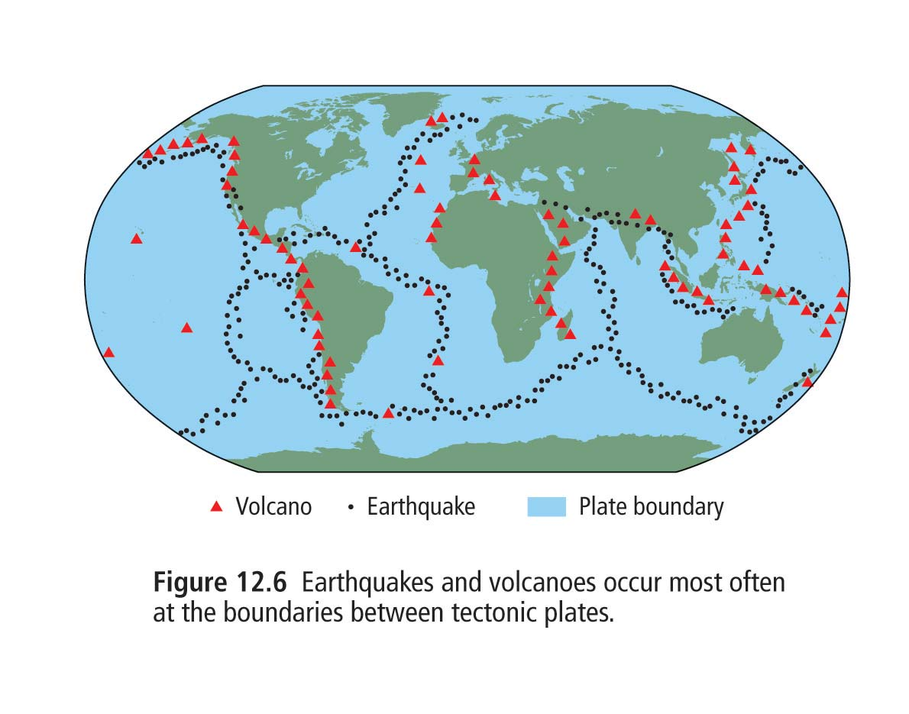

Slide 28
12. Define mid-atlantic ridge.
The longest mountain range on Earth, running north to south down the middle of the Atlantic Ocean.

Slide 29
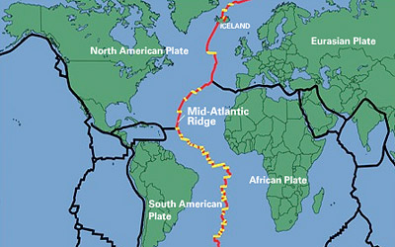

Slide 30
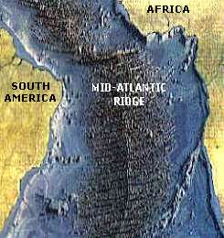

Slide 31
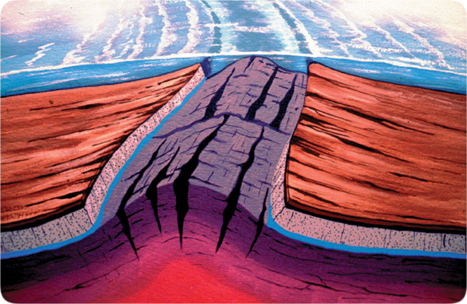

Slide 32
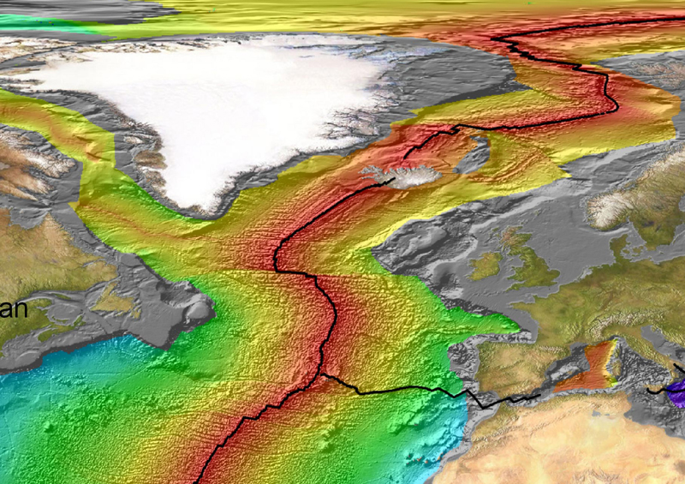

Slide 33
13. Where are the youngest rocks, close or far from the ocean ridge?
Close

Slide 34
14. Where is there more sediment, close or far from the ocean ridge?
FAR

Slide 35
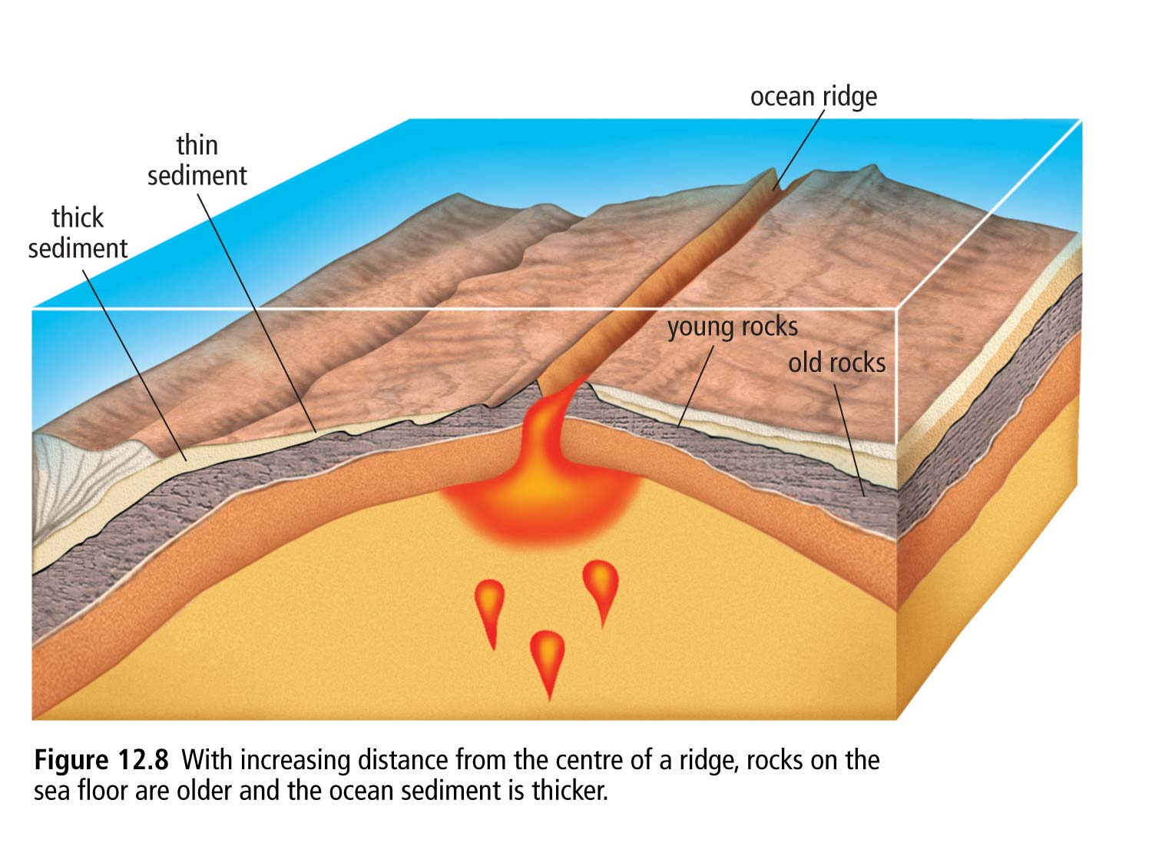
15. Sketch and label the diagram fig 12.8 of the ocean ridge.

Slide 36
16. What is magnetic reversal and paleomagnetism?
The process in which Earth’s magnetic field, over thousands of years, completely reverses its direction.
Paleomagnetism is the study of the magnetic properties of ancient rocks.

Slide 37
17. How does magnetic reversal support plate movement?
A striped pattern was repeated on both sides of the mid atlantic ridge.

Slide 38
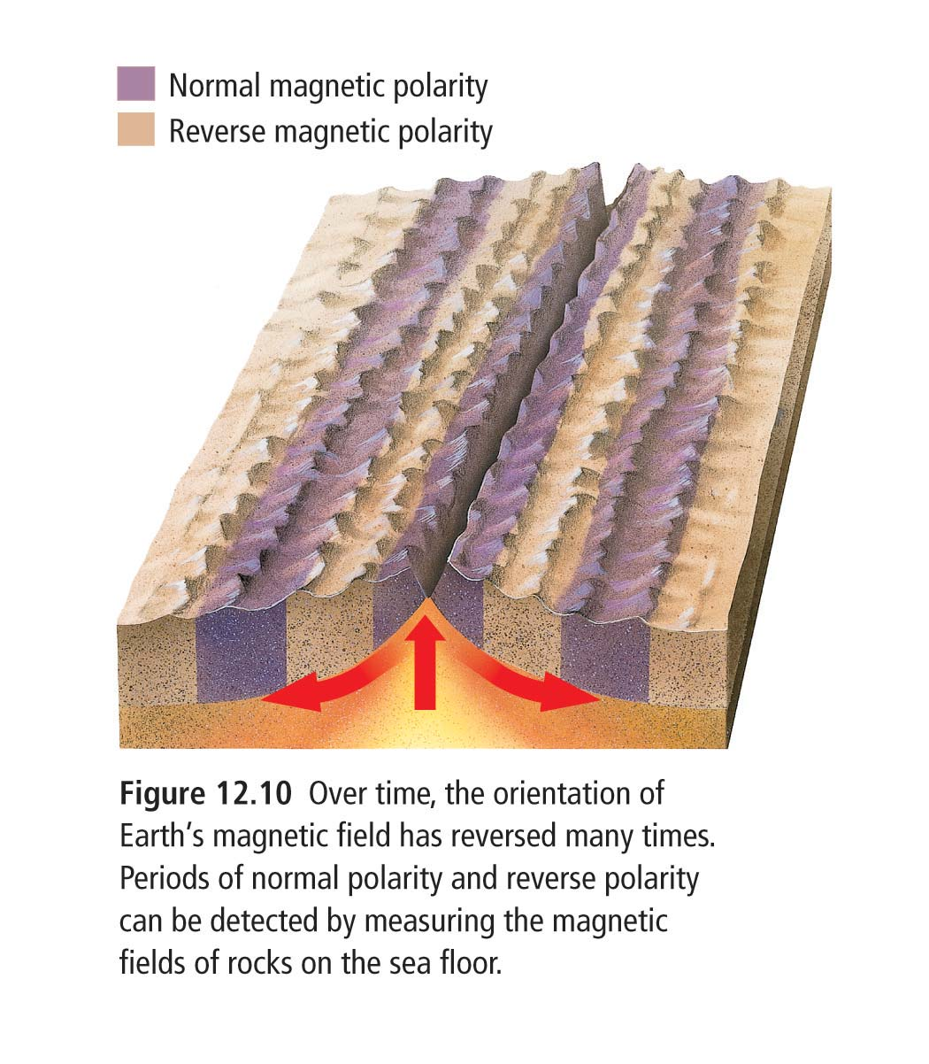

Slide 39
18. What period of earth magnetism are we in right now? See fig 12.9.
Normal polarity when the Earth’s magnetic poles are similar to its geographic poles.
N to N
S to S

Slide 40
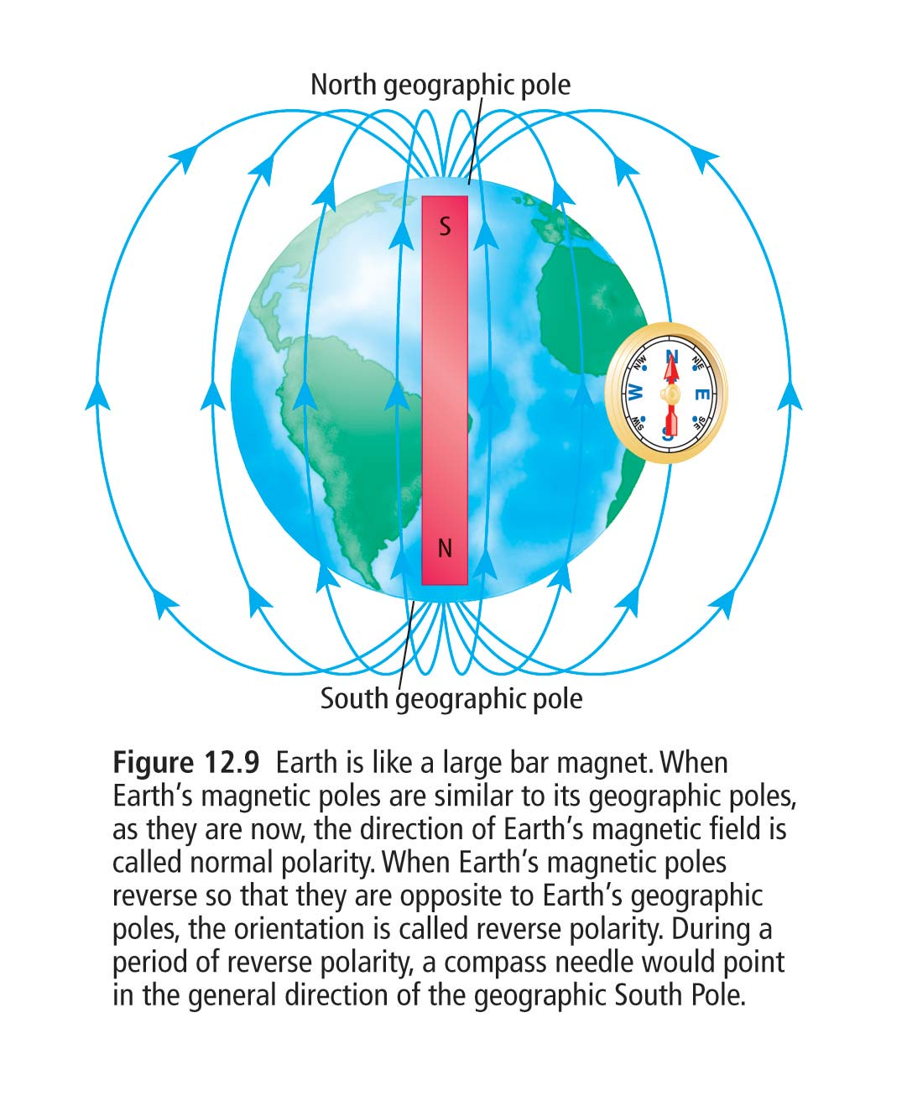
Text is a little
Wrong in this diagram

Slide 41
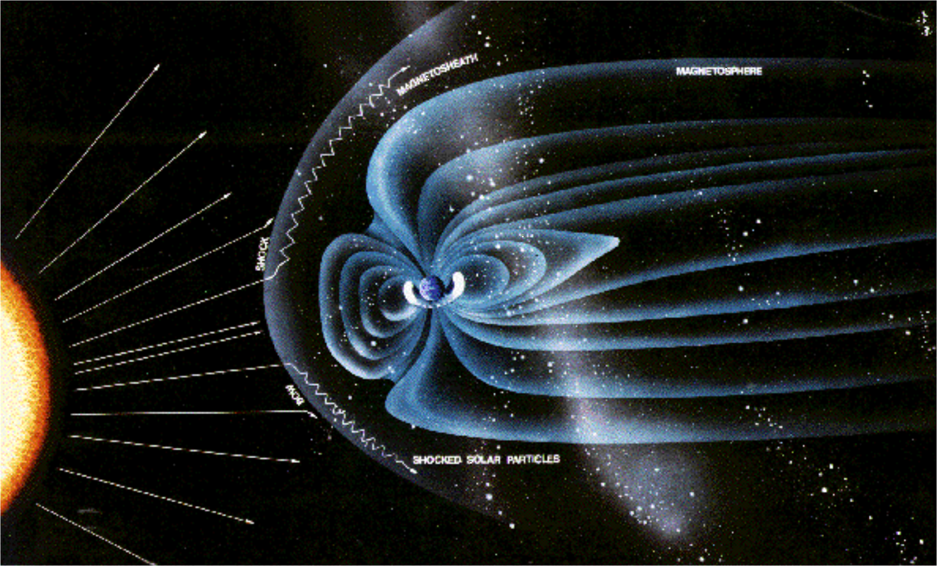

Slide 42
19. What is magnetic striping ?
The pattern in the rock containing iron type minerals that line up in the same direction as the past magnetic fields producing a striped pattern on the sea floor rock.

Slide 43
20. Define magma.
Molten rock beneath the Earth’s surface.
Lava – molten rock on the Earth’s surface.

Slide 44
21. Define spreading ridge.
A region where magma breaks through the Earth’s surface, continually forcing apart old rock and forming new sea floor.

Slide 45
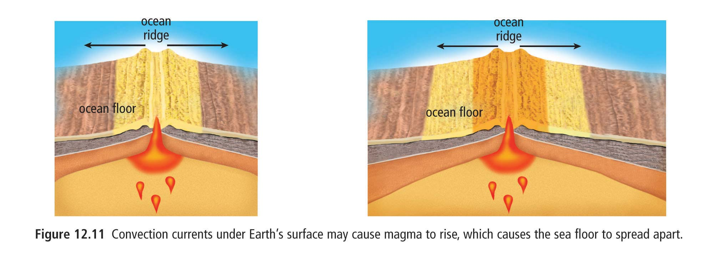

Slide 46
http://www.nature.nps.gov/geology/usgsnps/animate/pltecan.html
http://www.science-story.com/trenches-ridges.php

Slide 47
22. Define sea floor spreading.
The process in which magma rises to the Earth’s surface at spreading ridges and as it continues to rise, pushes older rock aside.

Slide 48
23. On a separate sheet of paper, summarize table 12.1 page 513. Put it into your own words.
Hess’ evidence of sea floor spreading
Earth like a bar magnet and has 2 poles
New ocean floor forms when magma surfaces. This also pushes older rock aside
Magma is molten basalt rich in iron. As the basalt cools it becomes magnetic.
Magnetic minerals aline like tiny compas needles

Slide 49
Earth’s magnetic poles reverse over hundreds of thousands years.
Minerals keep their alignment after magma cooled so some will have normal polarity and some will have reverse polarity.
Magnetic striping surround ocean ridges.
Pattern of striping is the same on both sides of the ocean ridge.
Ocean sediments are thicker farther away from the ridge. Older rock is farther away and has more time to collect sediment.

Slide 50
24. Define hot spot.
An area where molten rock rises to the surface.

Slide 51
25. What famous island chain is produced by a hot spot?
Hawaii

Slide 52
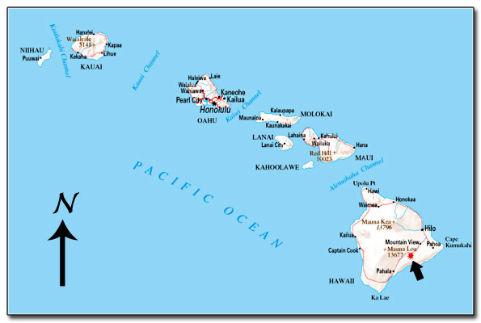

Slide 53
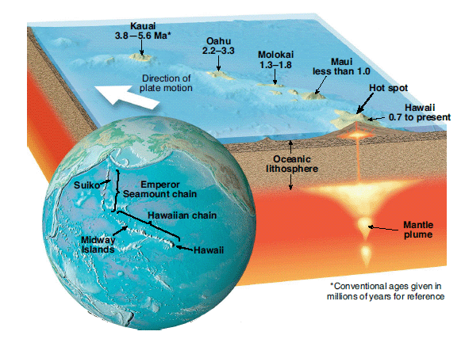

Slide 54
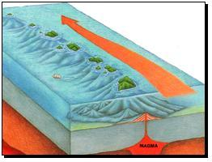

Slide 55
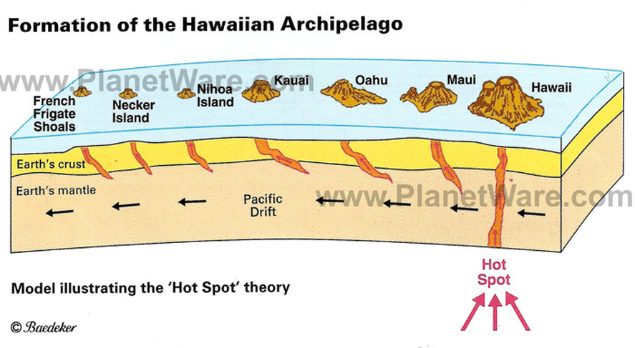

Slide 56
26. Define plate tectonic theory.
The theory that the lithosphere ( crust and upper mantle) is broken up into large plates that move and then rejoin
Considered the unifying theory of geology.

Slide 57
27. Read p 516 on geothermal energy and answer Q 1 – 3.
What is geothermal energy? Thermal energy from the earth’s core.
What are two ways in which people can use geothermal energy? Trap the steam to turn turbines to produce electricity and heating and cooling buildings
3 benefits of geothermal energy. Inexpensive to operate, non-polluting, renewable energy

