Slide 1
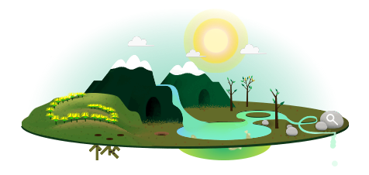
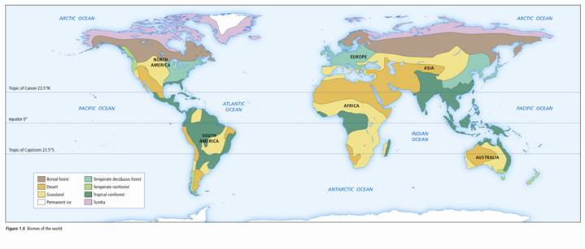
Unit 1
Sustaining Earth’s Ecosystem

Slide 3
1.1: Learning Outcomes
Identify distinctive plants, animals, and climatic characteristics of Canadian biomes (tundra, boreal forest, temperate deciduous forest, temperate rainforest, grasslands)
Identify biotic and abiotic factors in a given scenario or diagram
Identify factors that affect the global distribution of the following biomes: tropical rainforest, temperate rainforest, temperate deciduous forest, boreal forest, grasslands, desert, tundra, and polar ice.
Identify the three types of adaptations and give an example of each.

Slide 4
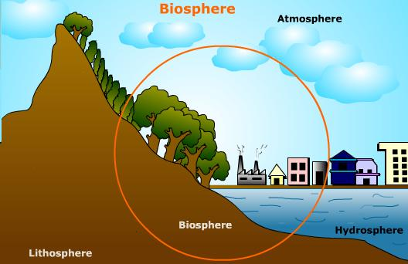
1.1: VOCABULARY
Abiotic
Biome
Biosphere
Biotic
Latitude
Temperature
Precipitation
Elevation
Climatograph
Structural adaptation
Physiological adaptation
Behavioural adaptation

Slide 5
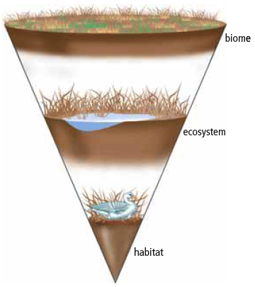
1.1 - Biomes
The word “biosphere” refers to the area on and near Earth’s surface where living things exist.
A biome is a region with similar biotic and abiotic components.

Slide 6
Definitions
Abiotic: anything that is non-living
Biotic: anything that is living

Slide 7
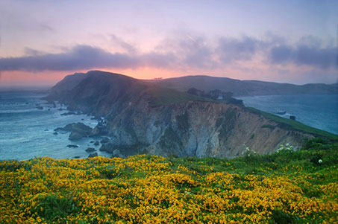
1

Slide 8
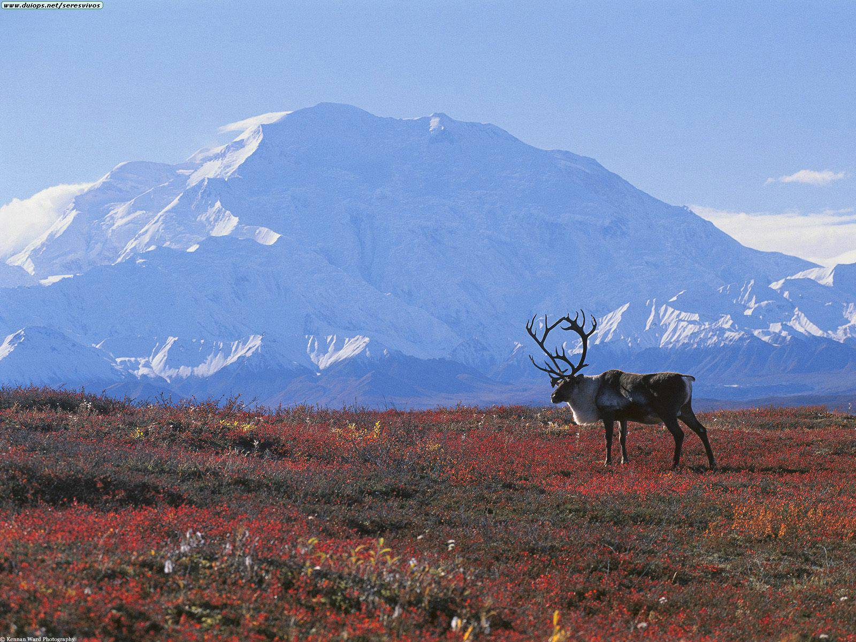
2

Slide 9
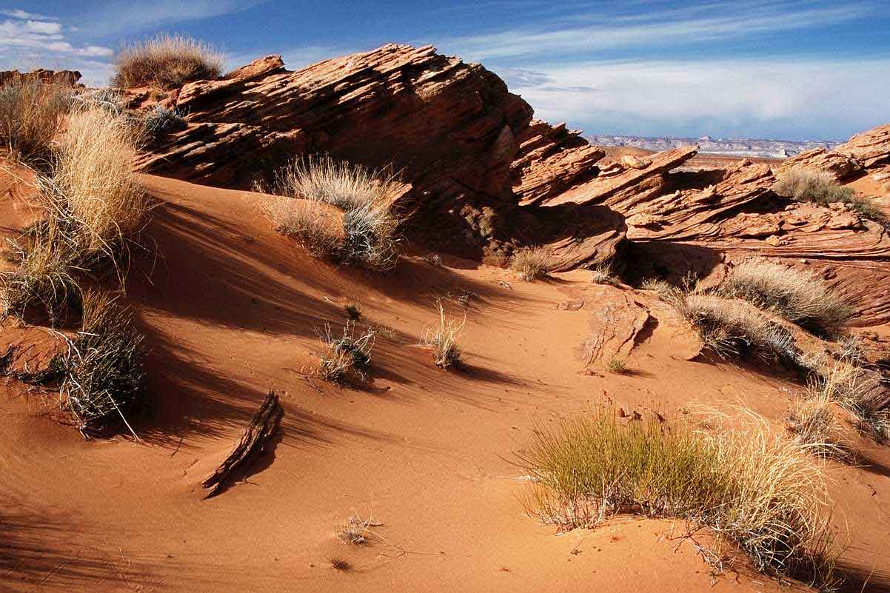
3

Slide 10
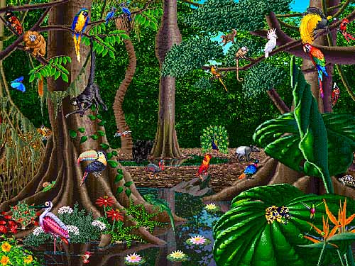
4

Slide 11
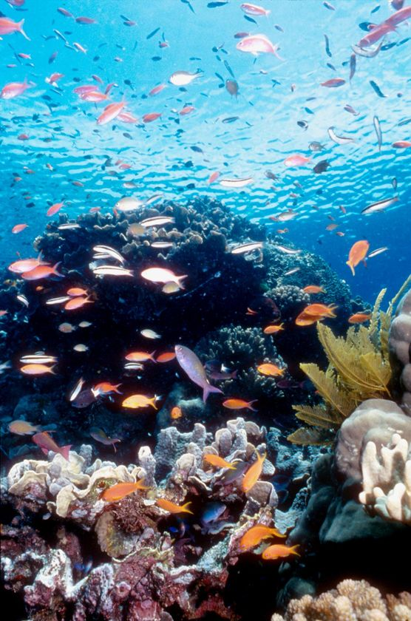
5

Slide 12
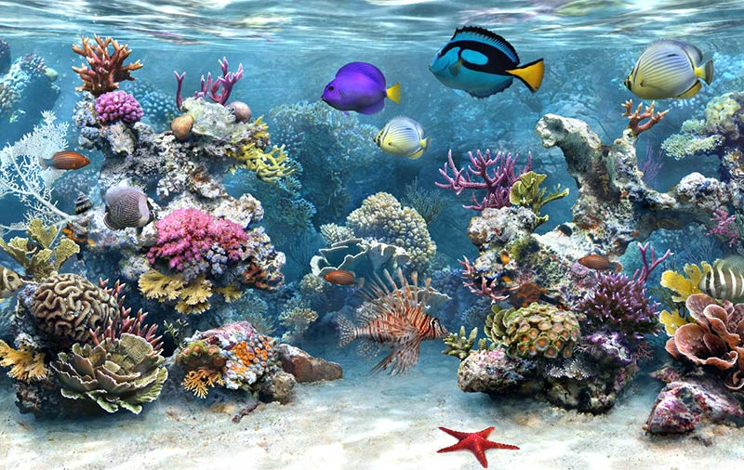
6

Slide 13
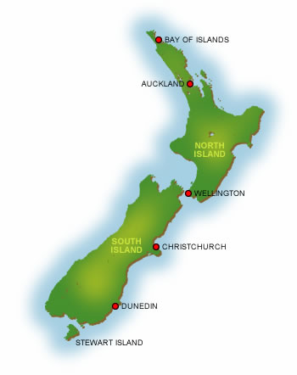
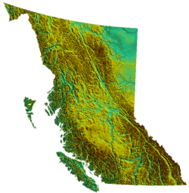
Biomes cont’d
If biotic and abiotic conditions are the same, similar biomes can exist far apart.
A biome here in B.C. can be the same as a biome in New Zealand.

Slide 14
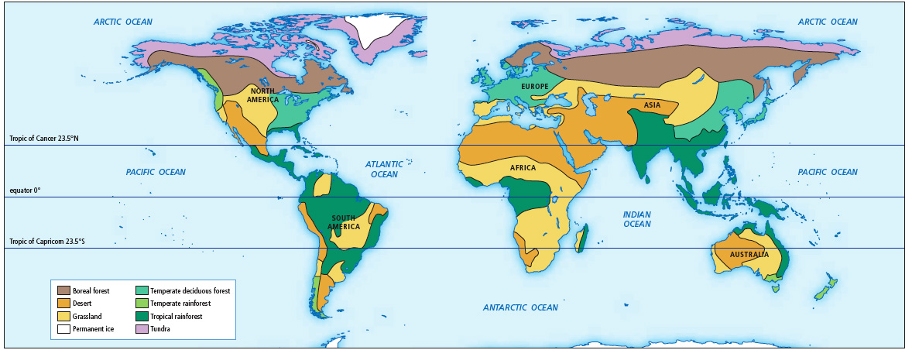
Biomes are classified based on many qualities, such as water availability, temperature, and interactions between biotic and abiotic factors.
Examples of Biomes: Boreal forest, desert, grassland, permanent ice, temperate deciduous forest, temperate rainforest, tropical rainforest, and tundra.

Slide 15
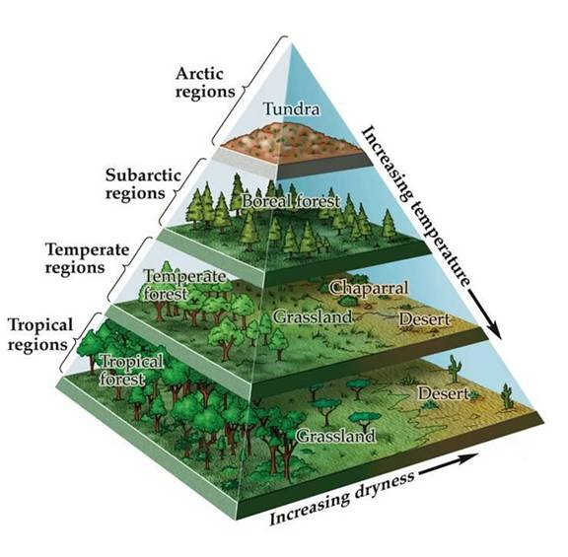
Certain characteristics help to identify biomes.
Temperature and precipitation are two of the
most important abiotic factors.
Other factors include latitude, elevation, and
ocean currents.

Slide 16
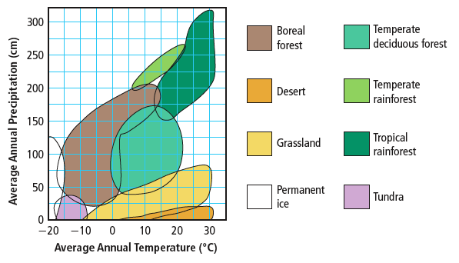
Factors that Influence Characteristics and Distribution of Biomes
Temperature and Precipitation
Two of the most important abiotic factors
Eg. Rainfall, snow, mist, and fog

Slide 18
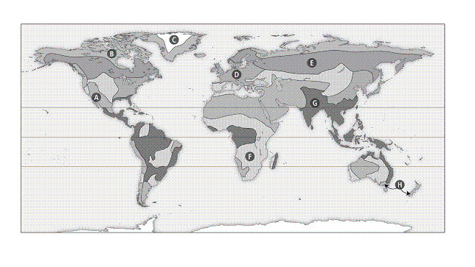

Slide 19
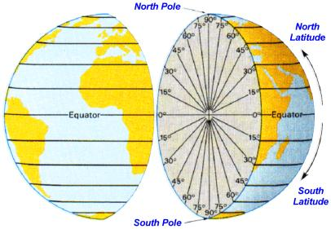
Latitude
Latitude is an abiotic factor that influences biomes.
Latitude is the distance north and south from the equator.
Latitude influences both temperature & precipitation.
The tropical zone has very warm temperatures and high precipitation.
The tropical zone receives more direct sunlight than do temperate zones.

Slide 20
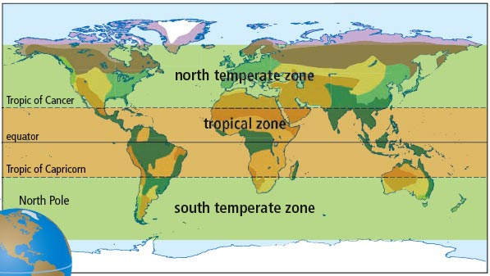
Latitude

Slide 21
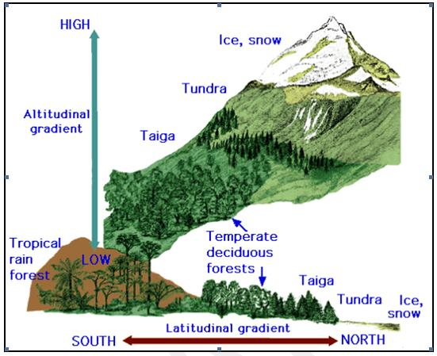
Elevation also influences biomes.
The atmosphere is thinner at higher elevations, and therefore less heat is retained.
Windward sides of mountains are wet, leeward sides are very dry.
Ocean currents carry warmth and moisture to coastal areas.
Where warm currents meet land, temperate biomes are found.

Slide 22
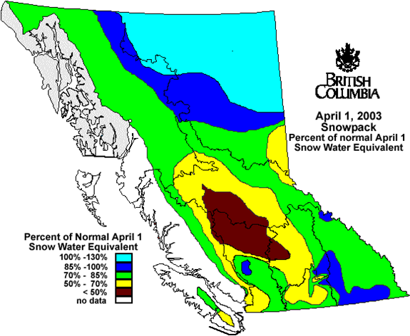
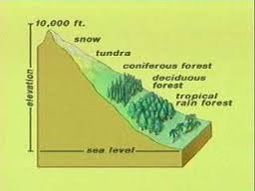

Slide 23
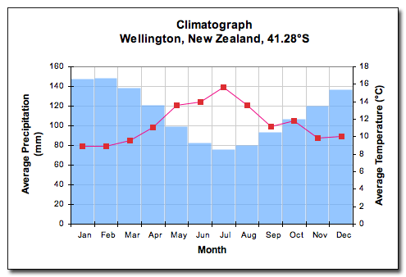
Climatographs
Climate refers to the average pattern of weather conditions of a large region over a period of 30 years or more.
A climatograph shows the average temperature and precipitation for a location over a period of 30 years or more.
Biomes are often defined using information in climatographs.
What differences would you expect to see between Tofino and Osoyoos?

Slide 24
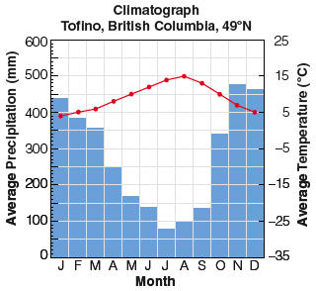
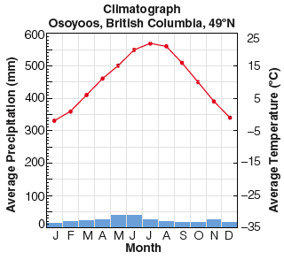
Climatographs

Slide 25
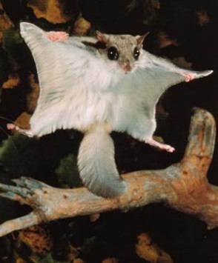
Adaptations and Biomes
Biomes are often identified with characteristic biotic (living) factors:
Ie: cactus in the desert or a caribou on the tundra.
Many of these characteristic factors have special adaptations for that biome.
An adaptation is a characteristic that allows an organism to better survive and reproduce.
There are three types of adaptations that we will be discussing

Slide 26
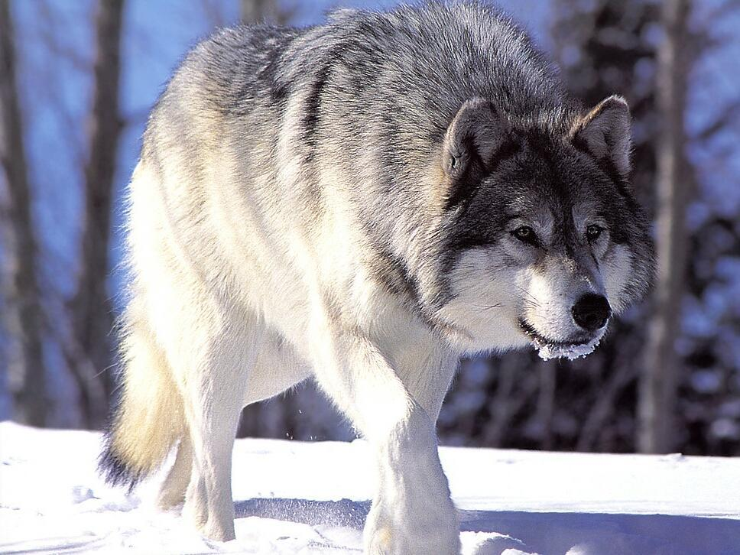
Adaptations and Biomes
Structural adaptation – a physical feature that helps an organism survive
A wolf has large paws to help it run in snow.
Notes:
Pine trees are cone-shaped and shed snow easily
Porcupines have sharp, stiff quills for defense
Arctic fox has thick, white coat in the winter and brownish-grey coat in the summer

Slide 27
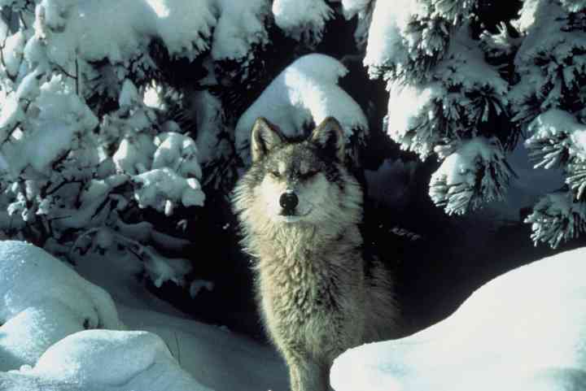
Adaptations and Biomes
Physiological adaptation – a physical or chemical event inside the body of an organism that allows it to survive
A wolf maintains a constant body temperature.
Notes:
-Process of photosynthesis in cacti is different from that in trees and ferns of temperate regions so they require half as much water

Slide 28
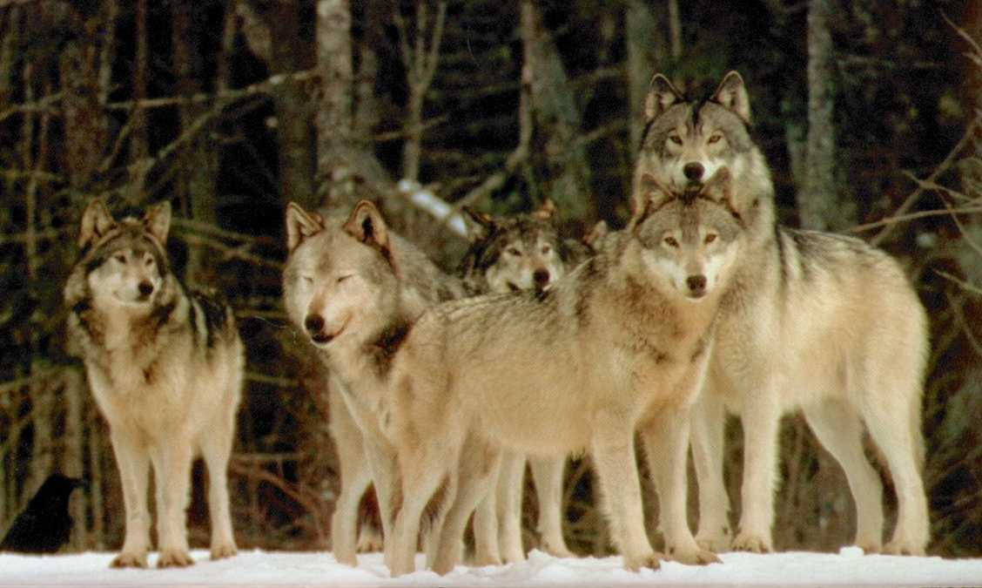
Adaptations and Biomes
Behavioural adaptation – a behaviour that helps an organism to survive
Wolves hunt in packs to capture large prey.
Notes:
- How the organism feeds, mates, cares for its young, migrates, hibernates, burrows, etc.

