Slide 1
Ecosystems
Section 1.2

Slide 2
What are ecosystems?
Part of a biome that contains abiotic components (oxygen, water, nutrients, light and soil) that support biotic components (plants, animals and micro-organisms.
Can be small (a rotting log) or large (Forest or grasslands)

Slide 3
Habitats
Found within Ecosystems
Habitat is the place in which an organism lives.

Slide 4
Habitats

Slide 5
\

Slide 7
Abiotic Interactions in Ecosystems
The abiotic factors within an ecosystem are important to the plants and animals that live there.
Think about it – a tree requires sunlight, water, soil and air
Water is VERY important as the cells of most living things contain 50-90% water
Nutrients are often carried by water from one ecosystem to another.
Sunlight required for photosynthesis – plants convert solar energy to chemical energy
Soil provides nutrients for plants and support many small organisms. (bacteria, fungus, insects etc.)

Slide 8
Biotic Interactions in Ecosystems
Species – group of closely related organisms that can reproduce with one another.
Population – All members of a particular species within an ecosystem
Community – All the populations of ALL THE DIFFERENT SPECIES that interact in a specific area or ecosystem.

Slide 9
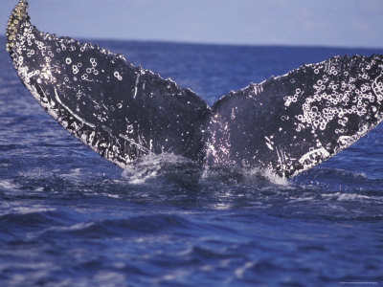
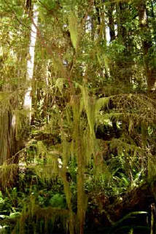
3 Types of Interactions Between Populations
Commensalism
Symbiotic relationship
One species benefits
Other species is neither helped not harmed.
May just be providing shelter or transportation
Example: Barnacles and Whales
Barnacles are transported to new location, whale is unharmed.
Example: Spanish Moss on trees in BC’s temperate rainforests.
Moss benefits by growing high in the canopy, tree is unharmed.

Slide 10
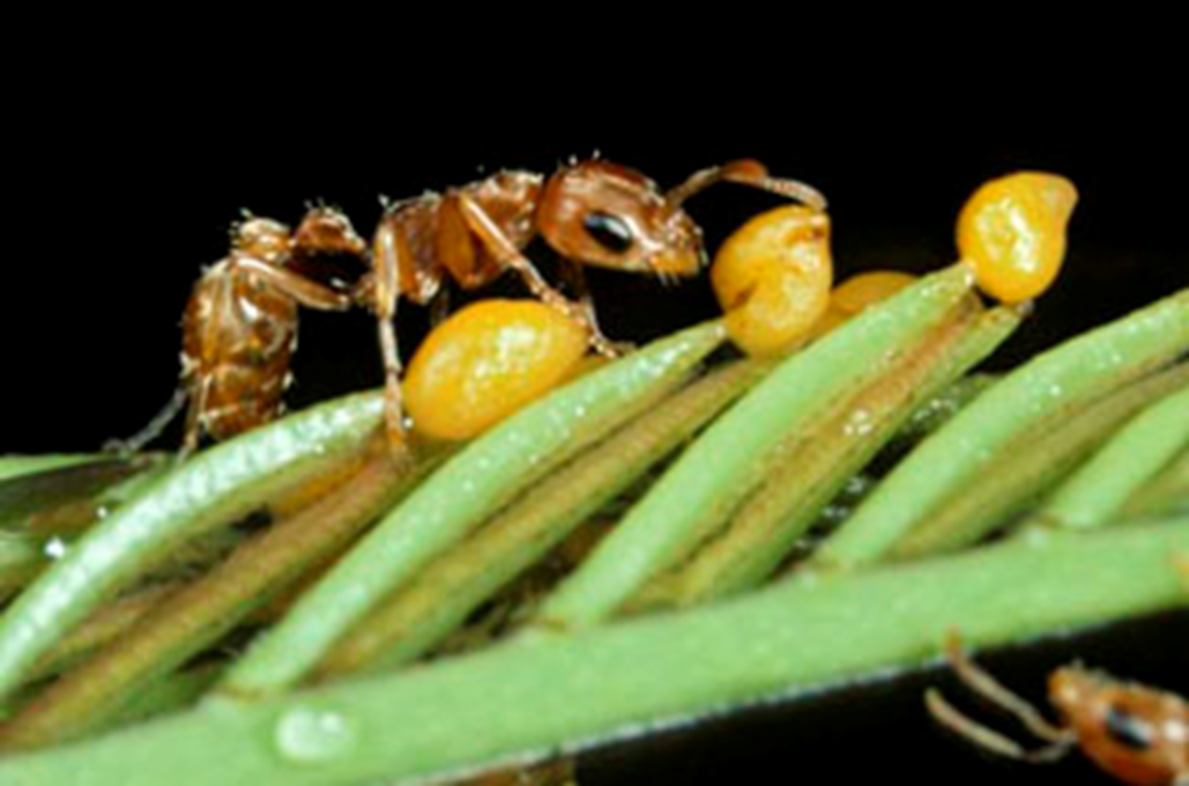
3 Types of Interactions Between Populations
2. Mutualism
Symbiotic relationship
BOTH organisms benefit
Example: Boreal Forest – Squirrel feed on underground fungus
Then distribute the spores of the fungus in their droppings
Promotes growth of more trees.
Example: Tropical Grassland – Aggressive Ant in bullhorn acacia bush.
Ant drinks nectar and protects the plant.

Slide 11
3 Types of Interactions Between Populations
3. Parasitism
Symbiotic Relationship
One species benefits
Other is harmed
Parasites are usually smaller than host and live on or in the body. Usually host is not killed but damage is done.
Example: Mountain Pine Beetle – lives in lodgepole and white pine.

Slide 12
Other Biotic Interactions -Niches
Niche describes the special role that organisms have in the ecosystems in which they live.
Includes the way in which the organism contributes to and fits into its environment.
All physical, chemical, biological interactions

Slide 13
Other Biotic Interactions -Competition
A harmful interaction between two or more organisms that can occur when organisms compete for the same resources (food, space, sunlight etc.)
Reduces the organisms ability to grow and reproduce – limits the size of a population
Some plants have characteristics to overcome – knapweed releases chemicals into the soil that prevents other plants from growing.

Slide 14
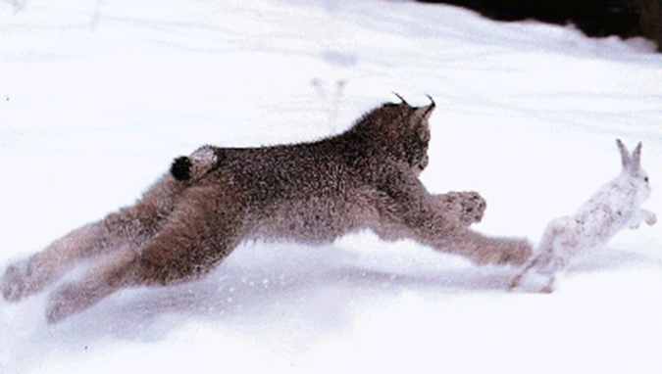
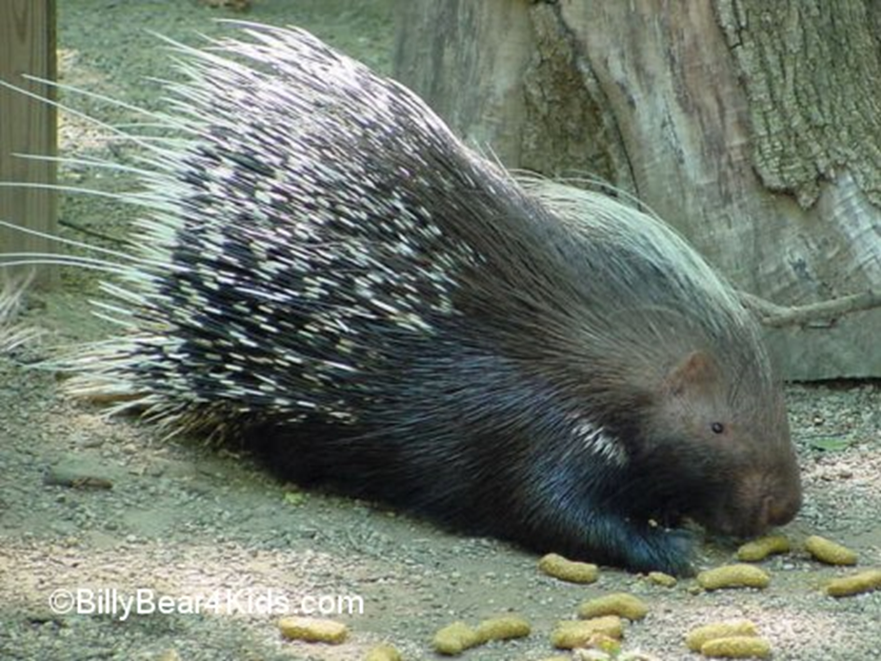
Other Biotic Interactions -Predation
Predation describes predator-prey interactions in which one organism (predator) eats all or part of another organism (prey)
Moves energy through the ecosystem (we’ll come back to this later)
Predatory animals have adaptations that make them effective
Highly developed senses or sharp pointed teeth etc.
Prey have adaptations to avoid being eaten.
Porcupines have spines, Turtles have hard shells, Camouflage

Slide 15
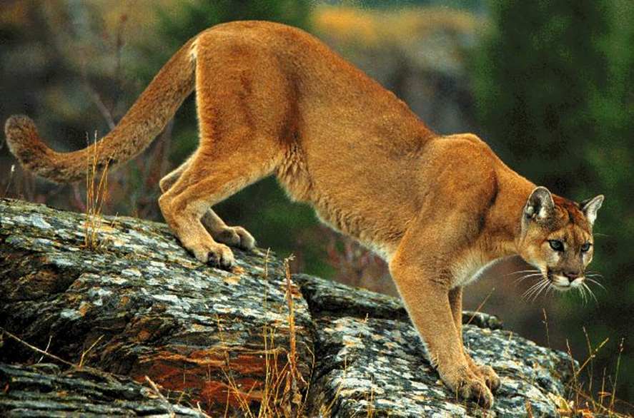
Predator-Prey Interactions

Slide 16
Predator-Prey Interactions

Slide 17
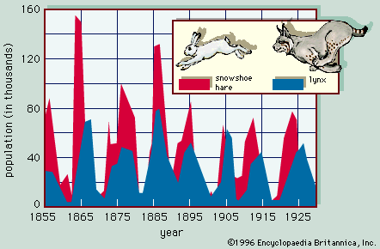
Predator-Prey Interactions

Slide 18
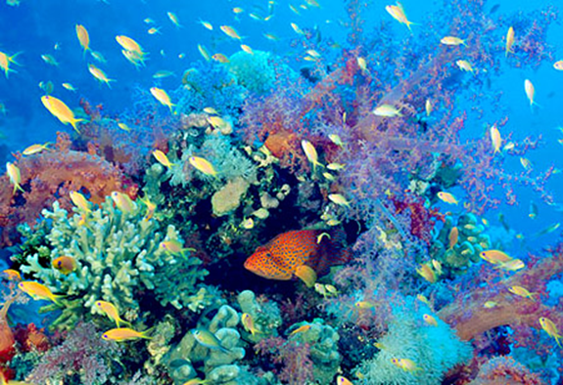
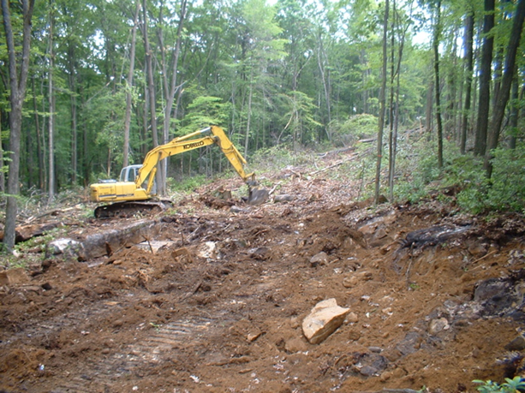
Biodiversity
Health of an ecosystem is indicated by a large variety of organisms in the ecosystem.
Biodiversity loss can be caused by habitat loss
Maintaining biodiversity in ecosystems is more difficult as humans continue to encroach on habitat. This is an ongoing problem in BC.

