Slide 1
Section 2.1 Energy flow in ecosystems

Slide 2
How does energy flow in an ecosystem?
Energy flow is the transfer of energy from one organism to another in an ecosystem. Every organism interacts with its ecosystem in two ways:
1. the organism obtains food energy from the ecosystem
2. the organism contributes energy to the ecosystem

Slide 3
How do organisms get energy?
Plants are producers because they “produce” food in the form of carbohydrates during photosynthesis.
Consumers eat plants and/or consumers to get their energy.

Slide 4
How are energy flow and feeding relationships modeled?
Ecologists use three models to illustrate
Food Chains
Food Webs
Food Pyramids

Slide 5
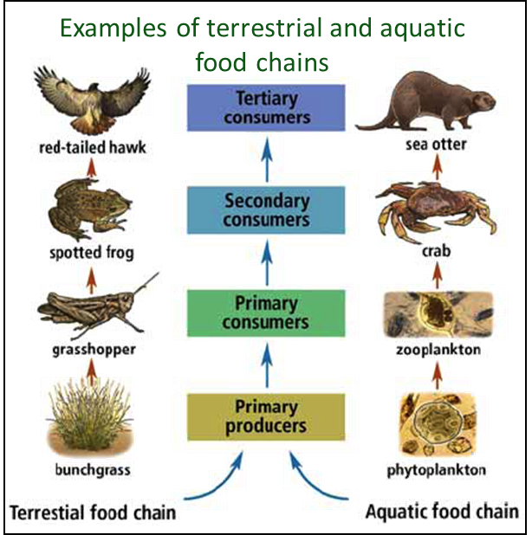
Food Chains
Food chains show the flow of energy from plant to animal and from animal to animal. Each step in a food chain is called a trophic level.

Slide 6
TROPHIC LEVEL | TYPE OF ORGANISM | ENERGY SOURCE | Example
1st | Primary Producer | Obtain Energy from the Sun. | Bunchgrass
2nd | Primary Consumer | Producers | Grasshopper
3rd | Secondary Consumer | Primary Consumers | Spotted Frog
4th | Tertiary Consumer | Secondary Consumers | Red-tailed Hawk

Slide 7
Food Webs
Many animals are part of more than one food chain in an ecosystem because they eat or are eaten by several organisms.
Interconnected food chains are illustrated in a model called a food web.

Slide 8
What does the Food web show us?

Slide 9
FOOD Pyramids/ecological pyramid
Model that shows the loss of energy from one trophic level to another.
When one organism consumes another, the energy stored in the food organism is transferred to the consumer.
NOT ALL OF THIS ENERGY is then stored in the consumer – between 80-90% of food energy is used for chemical reactions and is lost as heat.

Slide 10
FOOD Pyramids/ecological pyramid
Means ecosystems can support fewer organisms at higher trophic levels, as less energy reaches those levels.

Slide 11
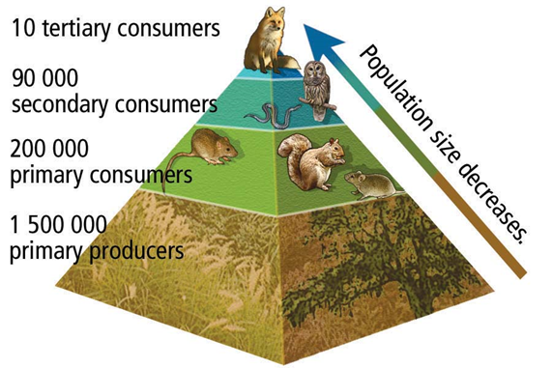
FOOD Pyramids/ecological pyramid
Means ecosystems can support fewer organisms at higher trophic levels, as less energy reaches those levels.

Slide 13
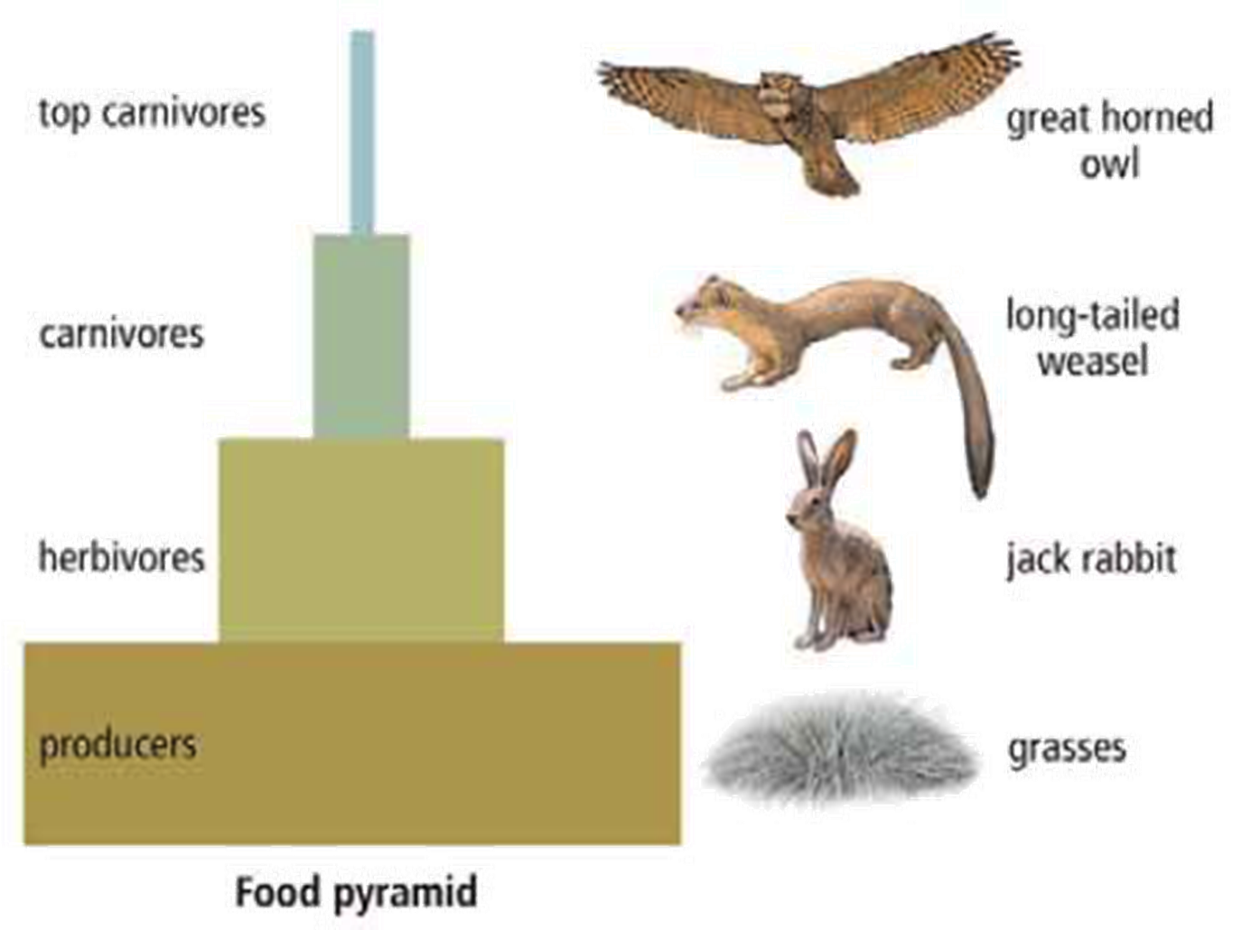

Slide 14
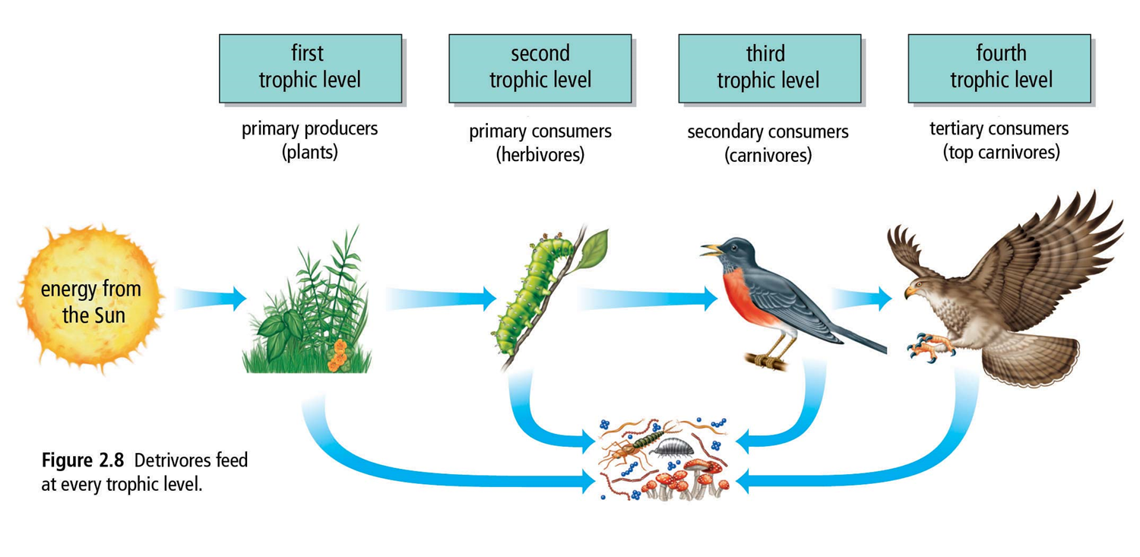
How do dead organisms contribute to energy flow?
Decomposition describes the break down of organic wastes and dead organisms. Energy is released in decomposition.

Slide 15
How do dead organisms contribute to energy flow?
When living organisms carry out decomposition, it is called biodegradation.
1. Detrivores – consumers that obtain energy and nutrients from dead organisms and waste matter
Examples include earthworms, bacteria and fungi.
Detrivores feed at every trophic level.
Detrivores have their own, separate food chains
and are very numerous.

Slide 16
How do dead organisms contribute to energy flow?
Decomposers (bacteria and fungi) change wastes and dead organisms into usable nutrients and release energy.

